Slide 1

Methods
University of Human Development College of Science and Technology Department of IT
Lecture :Programming
Lecturer: Tara Qadr
1st stage 2015-2016

Slide 2
Objectives
To define methods.
To invoke methods with a return value.
To invoke methods without a return value.
To pass arguments by value.
To use method overloading.
To determine the scope of variables.

Slide 3
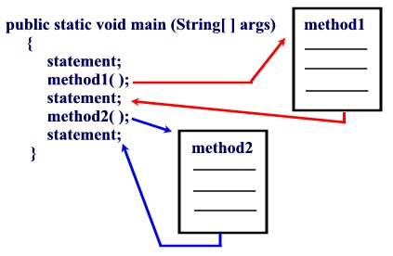
Methods

Slide 4
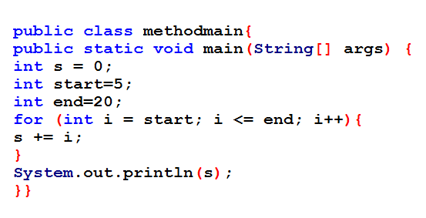
Consider the following program which sum numbers from 5 to 20

Slide 5
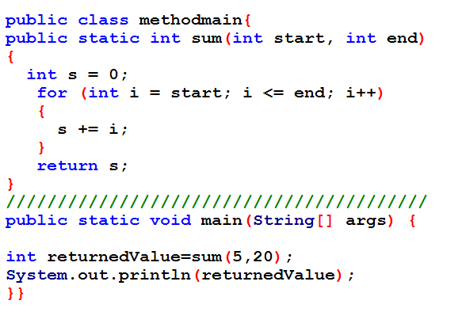
Previews example with method
Method body
Method call

Slide 6
Example
Suppose that you need to find the sum of integers from 1 to10, from 20 to30, and from 35 to 45, respectively. The code may written as follows:
int sum = 0;
for (int i = 1; i <= 10; i++)
sum += i;
System.out.println("Sum from 1 to 10 is " + sum);
sum = 0;
for (int i = 20; i <= 30; i++)
sum += i;
System.out.println("Sum from 20 to 30 is " + sum);
sum = 0;
for (int i = 35; i <= 45; i++)
sum += i;
System.out.println("Sum from 35 to 45 is " + sum);

Slide 7
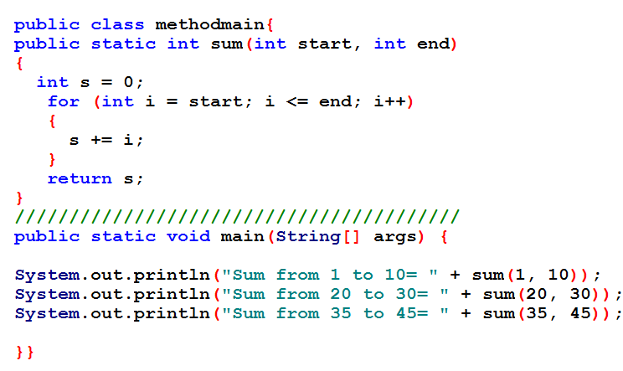
Example
Suppose that you need to find the sum of integers from 1 to10, from 20 to30, and from 35 to 45, respectively. The code may written as follows using method:

Slide 8
Introducing Methods
A method is a collection of statements that are grouped together to perform an operation.
Method is for creating reusable code.
Syntax for defining a method:
modifier returnValueType methodName(list of parameters) {
// Method body;
}

Slide 9
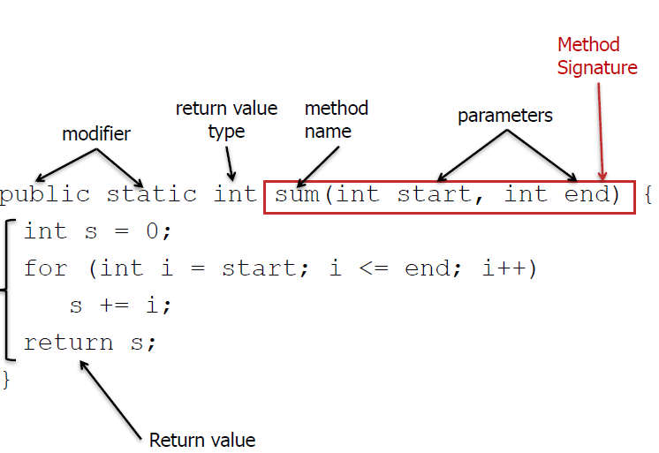
Introducing Methods (Cont.)
Method body

Slide 10
Introducing Methods (Cont.)
Method signature is the combination of the method name and the parameter list.
The variables defined in the method header are known as formal parameters.
When a method is invoked, parameters are replaced by variable or data, which are referred to as actual parameter or argument.

Slide 11
Introducing Methods (Cont.)
A method may return a value.
The returnValueType is the data type of the value the method returns.
If the method does not return a value, the returnValueType is the keyword void.
For example, the returnValueType in the main method is void.

Slide 12
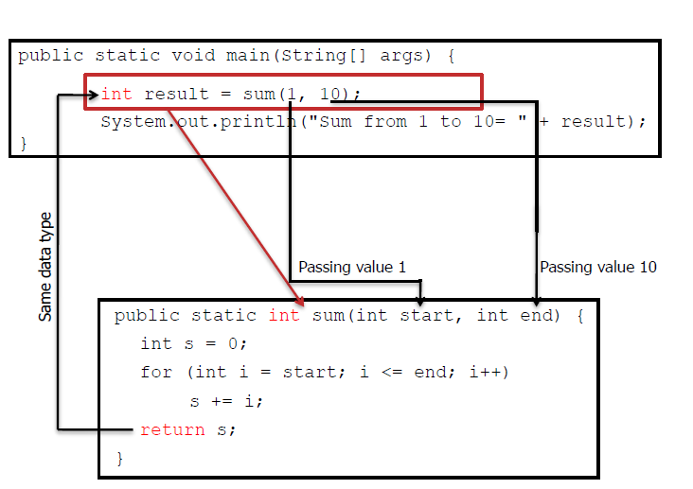
Calling Methods

Slide 13
Method depending on return value and having parameter(argument) are tree type
Have parameter and return type
Have parameter but not return type
Have not parameter and not return type

Slide 14
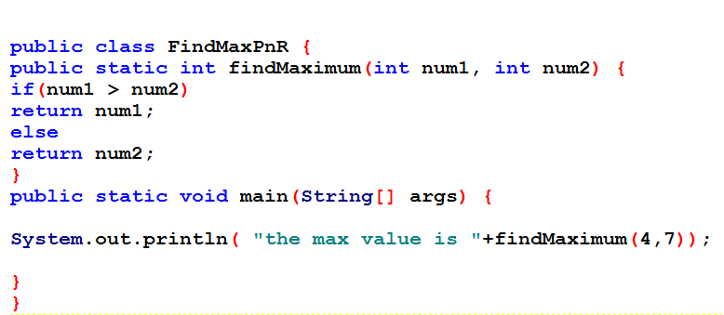
1.Have parameter and return type
In this case values should pass from main or another method , the method should return result to the place that invoked (called )

Slide 15
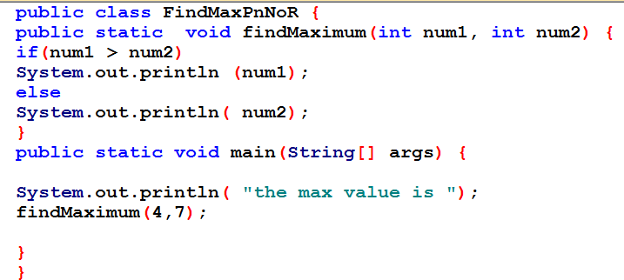
2.Have parameter but not return type
In this case the values pass but the result should print in side method ,not returned

Slide 16
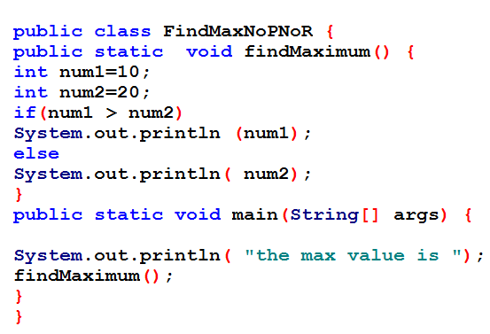
3.Have not parameter and not return type

Slide 17
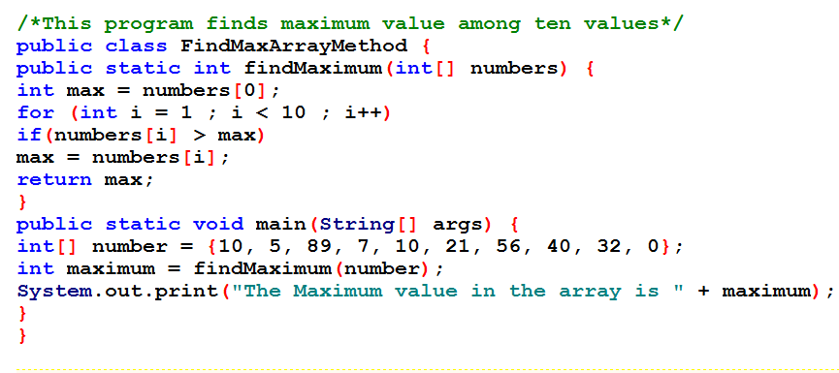
Example

Slide 18
Method Overloading
Two or more methods can have the same name within the same class .
The method’s parameter declarations must be different.
This is referred to as method overloading.

Slide 19
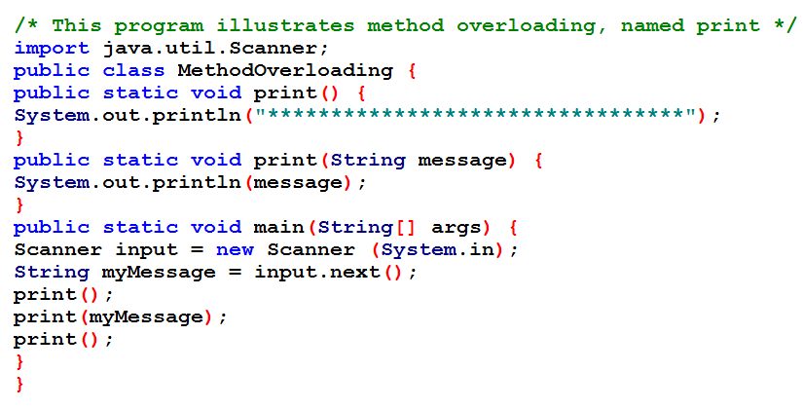
Example of overloading

Slide 20
Reference
Herbert Scheldt, “Java A Beginner’s Guide: Create, Compile, and Run Java Programs Today,” 5thEd.
Deitel, “Java How to Program”, 9thed., chapter 6, p. 197.
Liang, “Introduction to Java Programming”, 10thed., chapter 6, p. 203.

